Slide 1
SLYC Annual General Meeting 2023

Slide 2
Call to Order and Welcome
Greg Plant
1.0

Slide 3
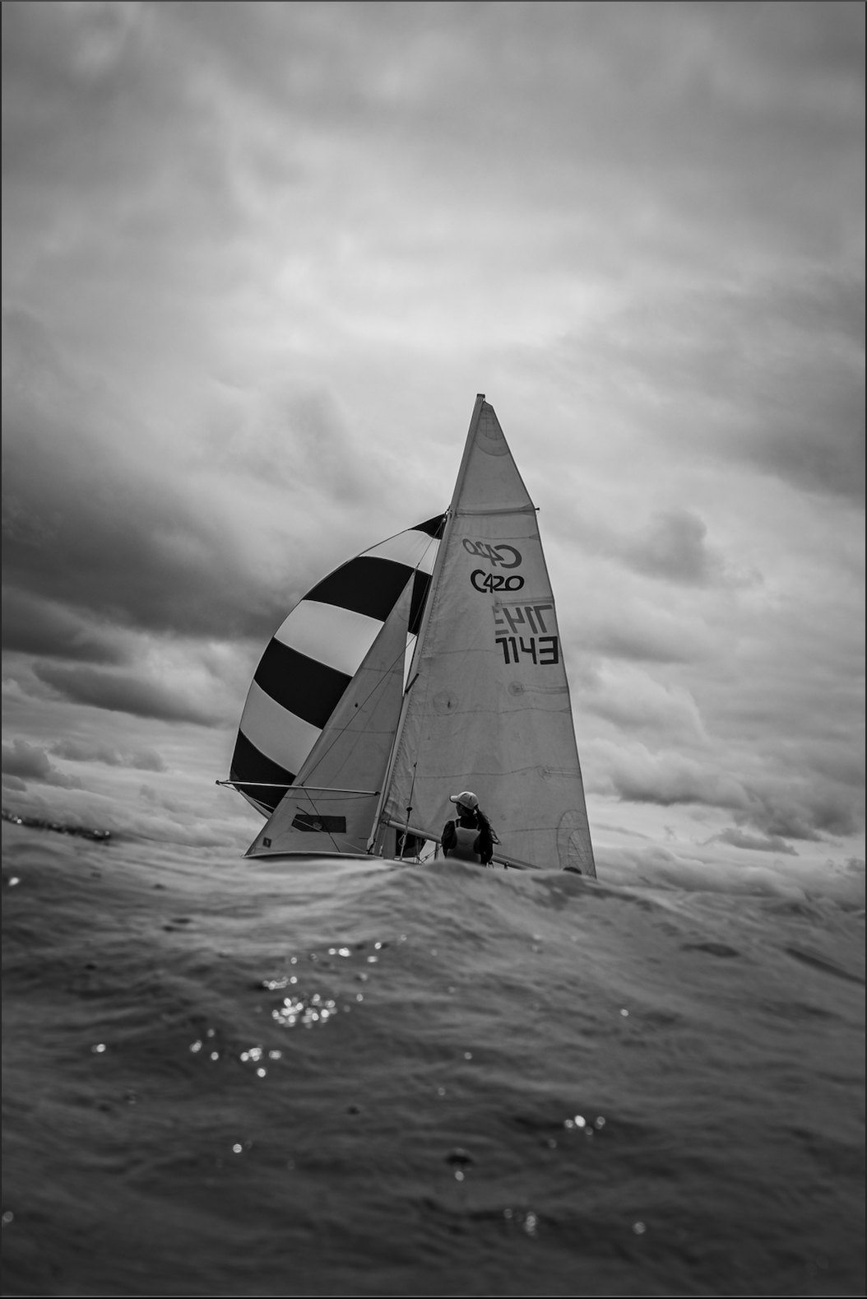
Agenda
Call to Order and Welcome - Greg Plant
Approval of Agenda - Greg Plant
Approval of Minutes, 2022 AGM - Greg Plant
Recognition Of Deceased Members - Greg Plant
Commodore’s Report - Greg Plant
Treasurer’s Report – Michele Macpherson
Audit Committee Report - David Newton
Fundraising/Strategic Plan - Dave Bart
Tennis & Pickleball Report – Andrew Rush
Golf Tournament – David Newton
Junior Sailing Report – Dave Anderson
Weekend Racing - Tam Matthews
Property - Jason Colbert
ASLC Liaison - Amy Drake Jacobs/Kelly Kennedy
Operations - Tom Pitfield
Membership- Cath Kirk
Social - Jackie Hubbs
Communications – John Craig
Nominating Committee - David Newton
Acts And Resolutions Of Board - Greg Plant
Other Matters - All
Adjournment - Greg Plant

Slide 4
Approval of Agenda
Greg Plant
2.0

Slide 5
Approval of 2022 AGM Minutes
Greg Plant
3.0

Slide 6
4.0
Recognition of Deceased Members
Christopher Bunting
Leon Cherniak
Jeremey Cummine
Gerran Ferrey
Fred Ross
George Thompson

Slide 7
SLYC Commodore’s Report
Greg Plant
5.0
As a quick update on Board responsibilities, here are some topline numbers: Club Members - 732, Grounds - 3.5 acres, Docks - 700+ lineal feet (213+ meters), Sailing Fleet - 44 boats, Coaching fleet - 3 boats, Tennis Courts - 3, Pickleball Court, Clubhouse, Tennis Hut - 1 each.
Here is a summary of our 2022/23 projects:
Membership Fees Restructuring
Amy Jacobs provided analytics and worked with me on our new membership fees structure based on individual all-inclusive memberships which is a departure from the family membership structure with different tiers for Sailing and Tennis. Under the new structure we’ve eliminated the perceptions of one set of programs subsidizing the other, and, smaller or single-parent families subsidizing larger ones. We’ve also introduced a low-cost Social Membership allowing those not participating directly in Sailing or Tennis to be connected with the club and allowing them to register their children for activities. Young adult and child fees are nominal and designed to keep young adults with the club and to keep fees as low as possible for young families.
New Court Reserve Software
Tom Pitfield spearheaded the project working with a group of our Board members and generously donating staff time and resources of his company Data Sciences. They researched 32 different tools to replace Mindbody, TennisBookings.com and Checklick which were causing us issues for various reasons, not limited to TennisBookings.com being shut down altogether. They landed on CourtReserve which we launched this spring. Checklick however is the national standard for junior sailing evaluations and we continue to use it for that purpose only. All other bookings and transactions are now done through CourtReserve which has been very well-received by our members.

Slide 8
SLYC Commodore’s Report con’t
5.0
Court 1 Drainage Remediation and Landscaping
Jason Colbert coordinated the project to fix the eroded path at the south end of Court 1 and to replace the river rock slopes which were unusable. The result is proper drainage for the area including a tiered rock retaining wall which acts as an amphitheatre style seating area for classes and casual use, as well as an enlarged yard area for general use adjacent to the Clubhouse. An amazing improvement to our grounds under constant use.
Expanding Docks
Jason also coordinated the expansion of our docks which is a work in progress to expand capacity and help reduce our parking congestion issue during peak times.
Clubhouse Fire Safety Upgrade
The Clubhouse needs some work to bring it up to current building code and we are speaking with the Township of Douro-Dummer and through our insurance broker Mitchell Sandham to our insurance company Premier Canada to ensure the building meets current standards. We are working with the design team of Chris Tworkowski and Sandy Smith who updated the store a few years ago. Once plans and permits are ready, we’ll start getting quotes and will be able to engage the Stony Lake Heritage Foundation for financial assistance and start work on the upgrade as soon as possible.

Slide 9
SLYC Commodore’s Report con’t
5.0
Safe Sport
Under Ontario Sailing, member clubs are required to adopt a Safe Sport Policy which lives up to the general principles and commitment of the Universal Code of Conduct to Prevent and Address Maltreatment in Sport (UCCMS). Ontario Sailing is working with SLYC in creating a set of documents and an implementation strategy for our club. Our current Codes of Conduct will be replaced by the new policy. SLYC’s Safe Sport Committee is made up of Andrew Rush, Dave Anderson, Kevin O’Callaghan, Rich Lavery and myself, and we are in the process of finalizing the policy with the goal of adopting it and putting it into practice for the 2024 Season.
Strategic Plan
Dave Bart, our Fundraising Director has taken on the task of leading the process of creating a Strategic Plan for the club which will help inform our long term funding needs.
Club Records – Dropbox to Google Docs
We are in the process of migrating our club documents and files from Dropbox to Google Docs. Beckie Bart and Amy Jacobs have been very active in the project.

Slide 10
SLYC Commodore’s Report con’t
5.0
ONCA Compliance
The Ontario Not-for-Profit Corporations Act (ONCA) came into effect in October 2021 and we are working with Fox Law in Peterborough to ensure we are in compliance.
Social – return of the Dinner Dance
Many thanks to Jackie Hubbs, Social Director and her team of volunteers in bringing back the Dinner Dance. This year we took the bold step of supplying food and entertainment for the event. All going well in 2024 we’ll be back in the Pavilion for the dance with the traditional full-service format.
Leading the SLYC Community
I also would like to acknowledge the time and expertise of those on the Board not mentioned in the various projects above who are:
Past Commodore, David Newton – who after another very successful Golf Tournament fund-raising effort is stepping down as Event Chair. This year, David also Chairs our Audit Committee and is Co-Chair of the Nominating Committee.
Kelly Kennedy, Member at Large has been shadowing Amy Jacobs as ASLC Liaison, and officially took over on the ASLC side at their AGM on July 1.

Slide 11
SLYC Commodore’s Report con’t
5.0
John Craig (JC), Communications Director does an amazing job keeping us up to date and on track with regular Newsletters, maintaining the website and keeping an eye on social media.
Michele Macpherson, Treasurer is piloting us through the business challenges related to the technology of our former software systems and migrating to new systems. The club is in good financial shape.
Cath Kirk, Membership Director is stepping off the Board after many, many years of dedicated service to the club. Cath has provided invaluable continuity and wisdom to our group and will be missed.
Andrew Rush, is stepping off the Board after two years as Tennis Director and a driving force behind the Juniper Island Survey. Andrew, with his infectious enthusiasm, is also the organizational backbone of Men’s Night.
Special thanks to all our volunteers who make our club run. I’d like to mention six non-board members who are major contributors as volunteers: Hilary Zimmerman who handles Payroll for all our staff, Richard Tattersall who is key to our Golf Tournament sponsorship drive, Tam Matthews who as Weekend Racing Advisor has rejuvenated our Weekend Racing program, John Elliot who sits on our Audit Committee , Andrew Parker who sits on our Nominating Committee, and Kelly Wells who sits on both our Audit Committee and Nominating Committee.
And finally, congratulations to all our paid staff and young volunteers led by Bethany Chittick in Operations, Sydney Rankin in Sailing, and Aiden Quennec and Steven Wells in Tennis & Pickleball. You have made this summer one of the best ever!
It’s an honour and a privilege for me to work with this very engaged and talented community - the Board of Directors, the volunteers, and the staff who are dedicated to maintaining the club and making it better for the future.
Thank you!

Slide 12
Treasurer’s Report
Michele Macpherson
6.0
2022 Financials were prepared by Allay LLP, Chartered Professional Accountants
The SLYC Audit Committee comprised of David Newton, Greg Plant, Kelly Wells and John Elliott reviewed and approved the financial statements
A financial summary is available to members by request to slycinfo@gmail.com

Slide 13
SLYC Audit Committee Report
David Newton, Chair
7.0
The audit committee of consisted of: David Newton, Greg Plant, Michele Macpherson, John Elliott and Kelly Wells
The committee met on and reviewed the 2022 financials and found them to be in good standing order.

Slide 14
Motion:
To accept the 2022 Financials as presented.
7.0

Slide 15
Motion:
To waive appointment of an auditor
for the upcoming year 2023/24
7.0

Slide 16
Fundraising/Strategic Plan
Dave Bart
8.0
We are overdue for a strategic plan to help guide us through the next 5 years
The club has grown and we need to take a close look at what our objectives are now and in the future
As such we are embarking on a strategic plan, starting with defining our mission, vision and values
This will help determine what our fundraising needs may be in the short term and long term
Next steps - additional town hall (finalize mission, vision, values), deep dive into our numbers (financial/usage), determine areas of need, determine what if any funds will be required to fund projects, create Strategic Plan and present to Board and Membership

Slide 17
SLYC Tennis & Pickleball
Andrew Rush
9.0
The goal for this year was to balance the desires of the members for free play, clinics, tournaments and lessons and develop our younger tennis pros.
We had a record number (15) of pros and volunteers - they did a great job serving all of the stakeholders, keeping the courts clean and dry - was challenging to get them enough court time.
Record number of entrants in the Club Championship.
The process of hiring a Head Pro for 2024 is already underway.
Considerations for 2024
Work in clinics/round robins for pickleball.
Balance number of pros with hours available to coach.
Continue to bring off-lake tennis pros in to experience the lake and the program for the future.
Pickleball and tennis continue to be strained for court time in July, need to keep considering how to make more time for more members available.

Slide 18
SLYC Golf Tournament
David Newton
10.0
Our annual golf tournament took place (despite some tricky weather conditions!) on August 8th.
Congratulations to the winning team comprising of JP Marchello, Dave Offierski, Eddie Beqaj, and Geoff Matthews, who achieved an impressive score of 58!
Over $50,000.00 raised towards our capital fund.
A heartfelt thank you goes out to all our sponsors who played pivotal roles – Gold, Silver, and Bronze – your support is immensely appreciated.
Event was completely sold out in just under 3 days, attracting a total of 112 participants.
Funds generated will be put to excellent use this upcoming fall, as we plan to resurface tennis court 3 and the pickleball court, in addition to procuring sailboats for our junior program.
Special gratitude goes to Wildfire and their outstanding staff.
Many thanks to everyone for contributing to this memorable event.

Slide 19
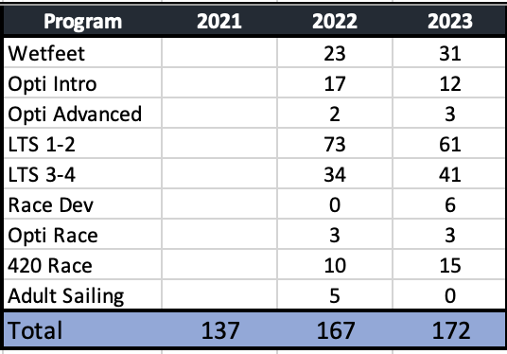
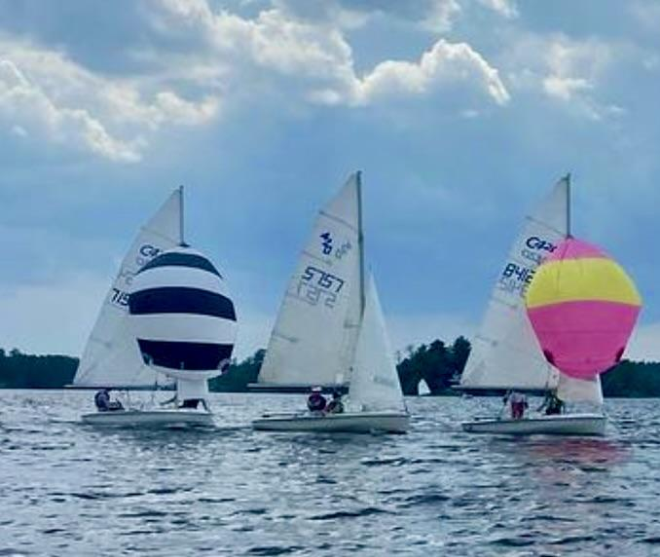
Junior Sailing
Dave Anderson
11.0
Program Year In Review
172 Sailors went through the program this year
Up from 167 in 2022 (3% growth)
Program Structure: 7 weeks, Mon-Fri 9:00 - 12:00 (morning session) and 1:00 - 4:00 (afternoon session)

Slide 20
Junior Sailing con’t
10.0
Instructors
16 instructors total
Sydney Rankin Head Instructor
4 race coaches (2 420, 2 Opti)
1 operations manager (half day coach)
10 learn to sail instructors
Contracts:
All instructors worked 8:30 - 4:30
1 eleven week contract, 2 nine week, 6 seven week, 7 five week
Our Fleet
Purchased 1 new coach boat, 2 race 420s, 3 race optis, 1 Zest
Repaired Zodiac to extend life 7-10 years
Current fleet:
7 Race 420s (2 new, 2 great, 3 good condition)
12 LTS 420s (CanSail 3-4)
9 Zests (CanSail 1-3)
3 Fevas (CanSail 1-30
13 Opti
8 Echos (Wetfeet & CanSail 1)

Slide 21
Junior Sailing con’t
10.0
Program Highlights
Invested in new boats and our fleet is very healthy
Introduce comprehensive pre-season safe sport training in partnership with Operations and ASLC
Continued focus on progression and not levels
Increased Instructor focus on evaluation process
Best evaluation statistics (consistency & completion)
Optimist fleet continues to be a popular program for younger sailors learn to race
Re-introduced Commodores & Spoons racing Tues & Thurs
Attended 3 off lake regattas: 8 boats at PCYC x 2, 8 boats at Cork
Opti race team attended 3 off lake regattas: 3 boats at PCYC x 2, 3 boats at LBSC
Continued culture of fun, learning and performance
Instructors: 10 of 16 instructors achieved advanced certifications (allows SLYC to deliver higher quality coaching and evaluations)
Goals for 2024
Limited fleet purchasing required
Review trailer safety (repair vs replace)
Focus on Program Quality
Continue to focus on discipline and clarity of evaluation (while focusing on sailing/skills and not levels)
Continue the SLYC tradition of promoting a lifelong love of sailing
Continue to educate parents/sailors on Opti racing and ILCA racing (two largest race fleets in world)
Ensure Cottage Club is hosted and that SLYC has a major presence

Slide 22
Weekend Racing
Tam Matthews
12.0
Leadership
Thank you to our Advisory Group of Gord Welsh, Dave Anderson and Maclain Walsworth for their ideas and suggestions to strengthen weekend racing participation and engagement.
Race Starters
We are grateful to our Junior Sailing Instructors who commit their weekend time to start the races.
Maclain Walsworth was our Head Starter with Assistants Rocky Walsworth, Sophie Green and Taylor Dalton.
Participation
There was a significant increase in participation this year with 15 boats in a number of races.
Moving the courses closer to the Yacht Club, shorter races and offering 2 or 3 races each day proved successful.
More Junior sailors participated this year, and 420s were made available to SLYC members.
Unfortunately, there were more race days cancelled this year due to no wind.

Slide 23
Weekend Racing con’t
12.0
Highlights
Rob Thompson and Sarah Sackville did an excellent job opening the season with the Annual Alumni Instructor vs Current Instructor Team Racing. The 2023 Instructor Team were the winners and Rob Thompson hosted a gathering afterwards.
Race days were held and the winners were:
420s: Peter Dipasquale and Sy Walsworth
Optis: Thompson Keenan
Lasers: Dave Anderson
SLYC Flags will be presented to all the trophy winners.
The Annual Catboat Regatta was successful with nine boats and some very close and competitive racing with wild winds, capsizing and rudders coming off. No matter the stories, the camaraderie grows every year.
Gord Welsh was the 2023 Champion, followed by Matt Ryder and Nick Strzalkowski
Sandy and Jennifer Beatty won the Prettiest Catboat (this was a new boat on the lake that Sandy restored)
Looking Ahead
John Heine is the new Catboat Commodore, and thank you to Gord Welsh for his eight years of service.
All sailboats are welcome to join us next year and there is no fee required!

Slide 24
Property
Jason Colbert
13.0
Property Director is needed for Aug 2024 if you know of anyone or would like to volunteer for the position contact me or Greg Plant.
Docks
New docks are in place. The kiss and fly, dock extensions and the floating docks. Some upgrades to existing docks for extra support to keep them stable has been done.
Club House
Club House fire rating is in process with the Engineer and Township. Some alterations will need to be made to comply. Such as Stair configuration, fire rated glass in areas to mention a few. Greg Plant has been the lead on this.
Tennis & Pickleball Courts
Court 3 and Pickleball courts are tentatively scheduled with Tennex to be painted in September
New Pickleball net is up and needs final finishing on post supports
Landscaping
The new grass and rock area has held up nicely. The grass will need tending to for the fall season
New drainage has held up during all the rain we have had this year with no erosion issues
Bushes have been planted at base of court one (thanks Greg and volunteers)

Slide 25
Property con’t
13.0
Part-time Staff
This position is being looked at for a full time position next year (2024) split between the ASLC and the SLYC
This year the part time position was a trial but due to the applicants other work schedule they were limited on the time they could spend at the island. Good for reviewing and altering for next year, this position is needed and is being discussed as a position to take care of the ASLC and the SLYC properties.
Opening/Closing
Docks to come out in September (either the 16 or 23) anyone able to help out is greatly appreciated. Notice will go out in a newsletter and emails.
This is one of the tasks we are going to separate and looking for a dedicated person to oversee as a sub committee to the Property Director on the opening/ closing and maintenance of the docks.
Opening of 2024 will be some time in May/June of 2024
Looking Ahead
Discussing full time seasonal position between the ASLC and SLYC
Before the start of next season (July 01) the ideal is that the Club House is finished with the fire rating upgrades, a storage shed for Property items is put in place and the grounds are ready for members to enjoy on July 01, 2024
The property position is being segmented into several sub committees. There will be positions for a person(s) to oversee work alongside the Tennis director on items related to tennis, items yet to be defined. Another position is to oversee the full time seasonal ground position (with the ALSC), Club House maintenance, and common
ground keeping areas.
And a position for someone to oversee docks - opening/ closing and maintenance throughout the season.

Slide 26
ASLC Liaison
Amy Drake Jacobs & Kelly Kennedy Henderson
14.0
The SLYC and ASLC boards continue to have a strong relationship built upon a shared vision of Juniper, mutual respect, and strong communication.
The ASLC/SLYC liaison attends all board meetings of both organizations, which gives them a unique perspective on those issues that impact our shared members, Juniper Island, and our beloved Stony Lake.
The liaison helps facilitate SLYC & ASLC coordination and communication, which is vital to ensure that SLYC and ASLC members experience a unified “Juniper” experience. Over 60% of SLYC’s 228 member households in 2022 were also members of the ASLC.
Examples of ASLC/SLYC coordination include:
Syncing programming to allow for smooth transitions and fuller participation;
Working to provide a consistent booking system for all programs;
Shared property clean-ups and garbage collection to maintain a beautiful Juniper;
Sharing of facilities for events and parking (Sailors Dinner, Junior Sailing Banquets, Juniper Regatta);
Consistent and coordinated messaging of important information;
Coordinated lake-wide survey.
After four years as the SLYC/ASLC liaison, Amy will be transitioning out and Kelly in. Kelly has been a member-at-large on both boards this past year, so is in a strong position for a seamless transition.
The SLYC looks forward to working closely with Chad Tranter, President, and the current ASLC board on future shared Juniper projects. We thank Shannon Thibodeau, former ASLC president, and other outgoing ASLC board members, for all their time and dedication.

Slide 27
Operations
Tom Pitfield
15.0
Systems and Services:
This season, the Operations team led the club's migration from the previous year's platforms (Mindbody, Checklick, and Tennisbookings) to CourtReserve, effectively streamlining our systems for enhanced performance.
CourtReserve consolidates membership purchases, court bookings, programming, and event registrations, resulting in a more seamless and efficient experience for both members and staff.
CourtReserve Feedback:
Initial in-person member feedback for CourtReserve has been positive.
Compared to previous years, staff have noticed a significant decrease in system-related issues and member inquiries.
The consolidation of systems has increased staff productivity.
Looking ahead, we plan to send out a survey to collect feedback about CourtReserve after its’ first season implemented within the club.
We have also begun scoping requirements for integrating ASLC programing. This will include cost recovery and back end processing.

Slide 28
Operations con’t
15.0
Staffing:
SLYC was grateful to welcome back Bethany Chittick as the SLYC Executive Operations Manager
Bethany got the season up and running smoothly by:
Collaborating with our project managers, Meghan McEachern and Andrew Quinn, to facilitate the club's transition to CourtReserve;
Gathering employee payroll documentation and information, ensuring everyone was fully prepared before the start of the season;
Supporting our Social, Tennis, and Sailing Directors with running reports, setting up programming and event registration, and finalizing the tennis schedule.
Acknowledgments:
The Membership and Operations team would like to acknowledge the positive working relationship with the young adults running programming and a special thanks to David Newton, Michelle Newton, Louise Sugar, Richard Tattersall, and Dave Bart for leading fundraising efforts.
We would also like to give a huge thank you to Meghan McEachern and Andrew Quinn for all of their efforts this year supporting the SLYC.
Finally we want to thank Bethany for her years of service, hard work and professionalism. She will be missed!

Slide 29
Operations con’t
16.0
Looking Ahead:
Hire 2024 Operations Staff. Three new candidates will be interviewed next week by Tom, Cath and Bethany. The role will be divided into Membership/Operations and Fundraising/Events.
Continue developing transition manuals for new roles and CourtReserve.
Integrate ASLC programing into CourtReserve
CourtReserve will continue working with the operations team to improve the overall experience for next year.
Stay tuned for a membership survey which will help inform future decisions and allow members to provide feedback on CourtReserve, the new membership format, and the overall SLYC experience
SLYC will to continue to identify and pursue ways to improve the membership experience and operational efficiency while sustaining SLYC for years to come

Slide 30
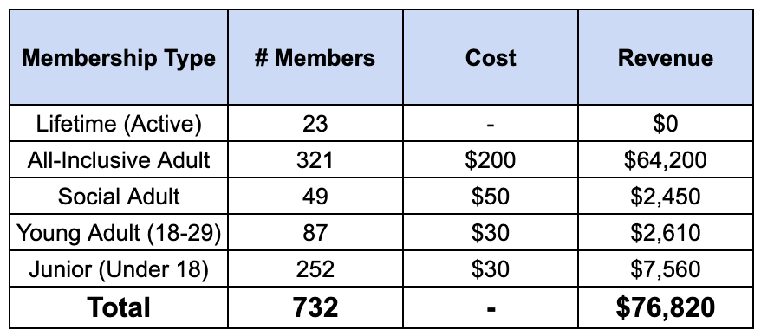
Membership
Cath Kirk
16.0
2023 Memberships Sold
SLYC introduced a new membership format this year, removing the Family Membership option and offering all Individual Memberships instead
204 families (2+ people) are recognized in CourtReserve, & 93 memberships are individual
Overall feedback has been positive on the new pricing system, particularly on the Social and Youth Memberships which have made membership fees more affordable for new and young members on the lake

Slide 31
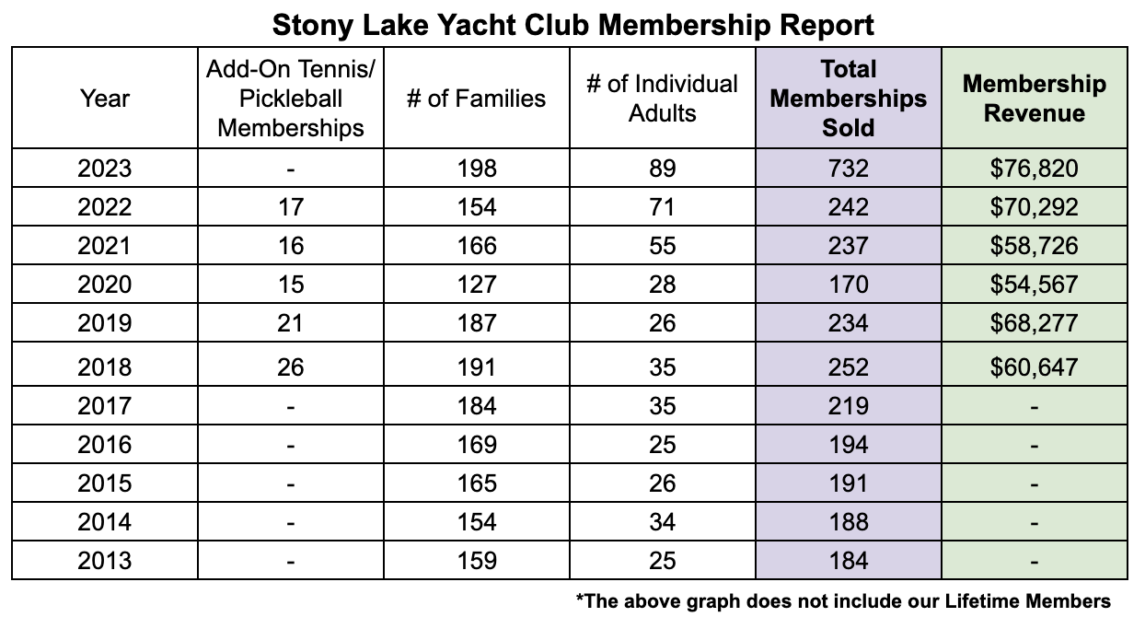
Membership con’t
16.0
Memberships Sold Breakdown
With the new pricing structure, membership revenue has increased by 8.5% (before system fees)
Individual Adult memberships represented 31% of memberships sold
Families represented 69% of memberships sold
Building on membership growth from 2022, SLYC continues to attract new members representing an estimated 7% of memberships sold
SLYC membership sales are strong, with the potential for increasing future demand

Slide 32
Social
Jackie Hubbs
17.0
A big thank you to everyone who participated in and helped organize the Opening Social and annual SLYC Dinner Dance, with particular mention of the board and all volunteers who made these events possible.
Opening Social
70 to 80 attendees.
BYOB and appetizers worked well and kicked off the season nicely.
Annual SLYC Dinner Dance
172 total tickets sold - 140 for dinner and 32 for the dance.
Revenue was $12,419 (Dinner - $11,695, Dance - $732)
We are still tabulating expenses but expect them to be around $4,000 so this event made money for the club.
We had a lot of positive feedback from this event.
Looking forward to the next year, where we will plan similar events.
Please feel free to offer feedback in ways we might improve.

Slide 33
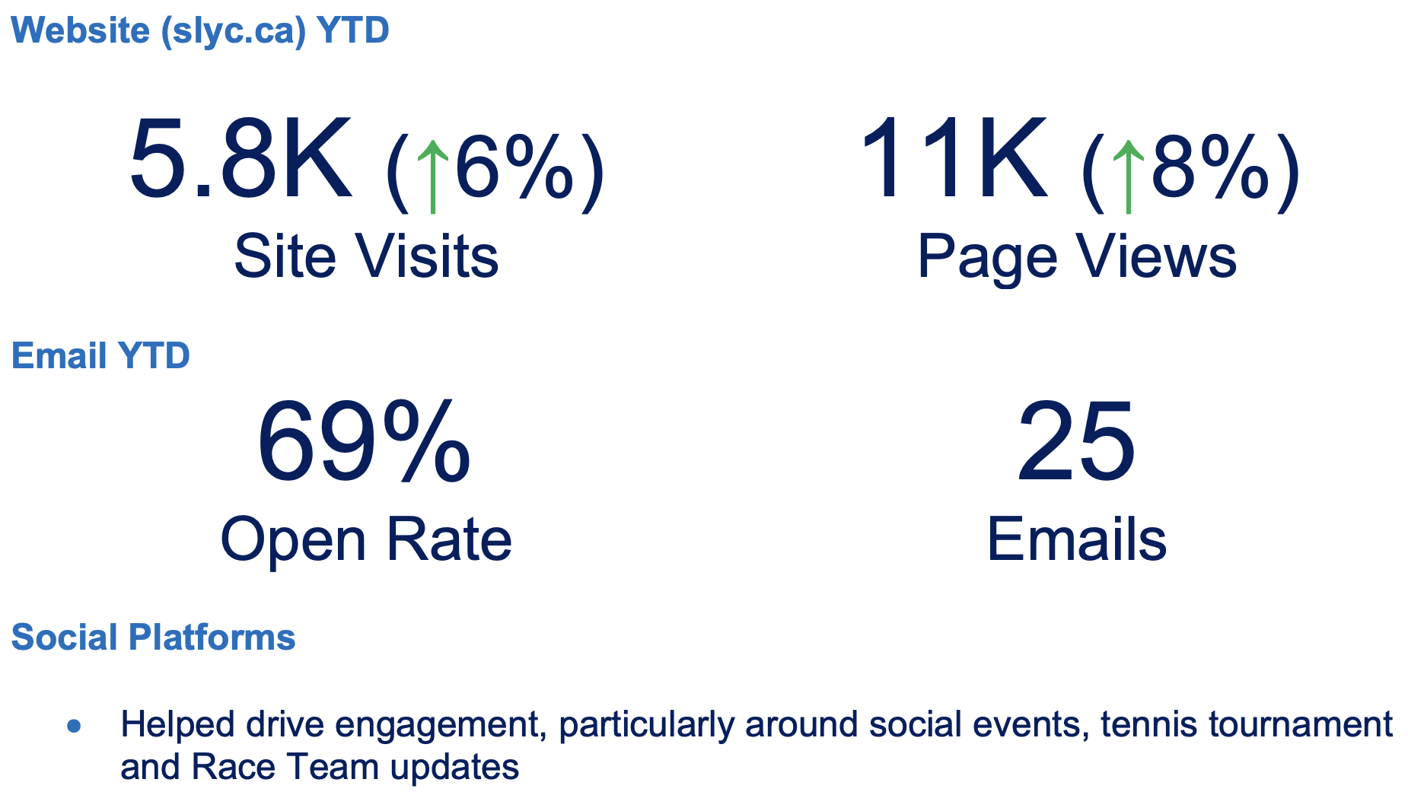
Communications
John Craig
18.0

Slide 34
Communications con’t
18.0
Acknowledgments
Thanks to our SLYC members for your readership and engagement (and for staying subscribed to our newsletter!).
Thanks to Commodore Greg Plant for a lot of heavy lifting (and first drafts!) behind the scenes.
Thanks to each and every SLYC Board member for bringing our communications to life!
Thanks to Bethany Chittick for her operations wizardry and above-and-beyond support.

Slide 35
Nominating Committee
David Newton
19.0
Members: Beckie Bart, David Newton, Andrew Parker, Greg Plant, Kelly Wells
2023 Nominations:
Membership: Andrew Parker (2 year term)
Tennis: Alex Brooks-Hill & Jody Scotchmer co-Directors (2 year terms)
Member at Large: Amy Jacobs (2 year term)
Member at Large: Kevin O’Callahan (2 year term)
Non-Voting: Kelly Wells shadowing Treasury role

Slide 36
Nominating Committee con’t
19.0
Board Composition for 2023:
Commodore – Greg Plant (1 year term)
Past Commodore (ex officio) – David Newton (1 year term)
Treasurer – Michele Macpherson (1 year term)*
Secretary – Beckie Bart (2nd year of 2 year term)
Membership – Andrew Parker (2 year term)
Operations – Tom Pitfield (2nd year of a 2 year term)
Fundraising – Dave Bart (2nd year of a 2 year term)
Communications – John (JC) Craig (2nd year of a 2 year term)
ASLC Liaison – Kelly Kennedy (2 year term)
Jr. Sailing – Dave Anderson (2nd year of a 2 year term)
Tennis & Pickleball – Alex Brooks-Hill (2 year term)
Tennis & Pickleball - Jody Scotchmer (2 year term)
Social – Jackie Hubbs (2nd year of 2 year term)
Member at Large (legal) – Kevin O’Callaghan (2 year term)
Member at Large (data/processes/Strategic Plan) – Amy Jacobs (2 year term)
Property – Jason Colbert (with sub committee support) (1 year term)
*Treasurer Shadow (non-voting) – Kelly Wells

Slide 37
Nominating Committee con’t
19.0
Motion:
I move that bylaw #5 be amended as follows to reflect our new membership structure:
From:
2.2 Voting Members
Voting members of the Corporation shall consist of all members who are at least twenty-one years of age and who are shown in the records of the Corporation as being paid up members in the Life, Single, Intermediate or Family category of membership.
To:
2.2 Voting Members
Voting members of the Corporation shall consist of all members who are at least eighteen years of age and who are shown in the records of the Corporation as being paid up members in the Life, Adult 30+, Social Adult 30+, or Young Adult 18-29 category of membership.

Slide 38
Nominating Committee con’t
19.0
Motion:
I move that bylaw #5 be amended as follows to allow for a maximum of 16 Directors so that some portfolios may have co-directors:
From:
3.1 The affairs of the Corporation shall be managed by a Board of Directors (the “Board”), each of who at the time of his/her election or within ten days thereafter and throughout his/her term of office shall be a member of the Corporation. The Board shall have a minimum of nine and a maximum of fifteen Directors not including the Honourary Commodore, if one is elected. This number shall be determined at each Annual Meeting.
To:
3.1 The affairs of the Corporation shall be managed by a Board of Directors (the “Board”), each of who at the time of his/her election or within ten days thereafter and throughout his/her term of office shall be a member of the Corporation. The Board shall have a minimum of nine and a maximum of sixteen Directors not including the Honourary Commodore, if one is elected. This number shall be determined at each Annual Meeting.

Slide 39
Nominating Committee con’t
19.0
Motion:
That the Members accept the slate as presented for the 2023/24 season by the Nominating Committee with changes to directorship as noted.

Slide 40
20.0
Motion:
To approve acts and resolutions
of the SLYC Board of Directors.

Slide 41
Any Other Business
21.0

Slide 42
Motion to Adjourn
22.0

